Slide 1
Specialised Plant Cells- Photosynthetic and Guard Cells

Slide 2
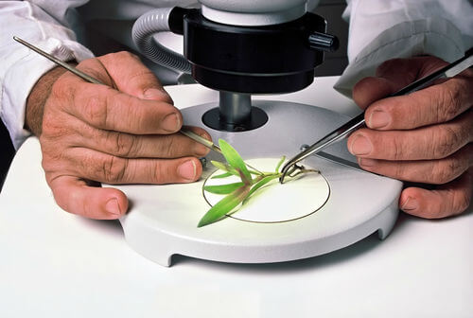
In this Smart Lesson, you will be doing the following:
1. | Describing the structure of 2 types of specialised plant cells: photosynthetic cells and guard cells.
2. | Explaining the function of these specialised cells.

Slide 3

All plant cells work together to help the plant grow.
A plant's roots are covered in specialised root hairs, which absorb water from the soil.
This water is transferred to the leaves through specialised conducting cells.
Carbon dioxide is absorbed using specialised guard cells in the leaves.
The water and carbon dioxide is turned into food by the specialised photosynthetic cells, using sunlight.

Slide 4
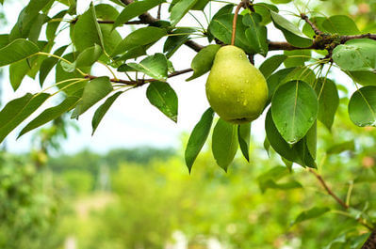
Photosynthetic cells, as the name suggests, carry out most of the plant's photosynthesis.
They are found near the surface of leaves and stems, as they need to absorb sunlight in order to function.

Slide 5
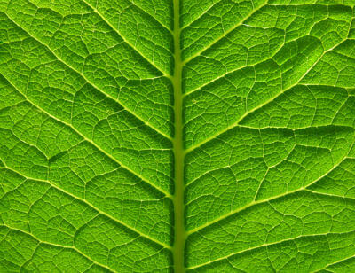
They contain many chloroplasts and mitochondria.
Chloroplasts contain the pigment chlorophyll, which gives leaves their green colour and absorbs light energy for photosynthesis. Mitochondria provide energy for photosynthesis to occur.

Slide 6
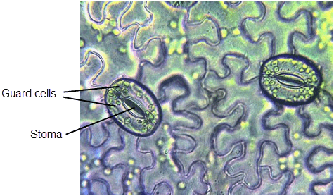
Gases that are needed by the plant for photosynthesis enter through tiny holes in the leaves and stems.
These holes are called stomata (singular=stoma). Gases that are not needed leave in the same way.

Slide 7
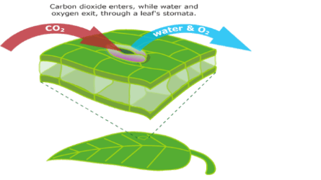
For example, carbon dioxide needed for photosynthesis enters the plant through the stomata, then the oxygen produced by photosynthesis leaves the plant through the stomata.

Slide 8
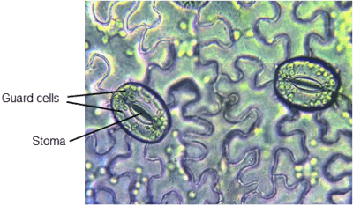

The diameter of these holes, and whether they are open or closed is regulated by guard cells.
They work in pairs to open and close the hole, controlling the rate of entry and exit of gases.

Slide 9
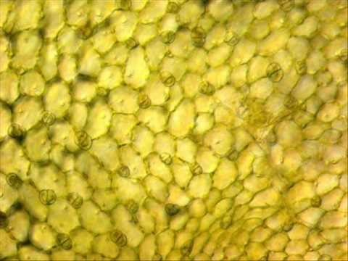

Slide 10
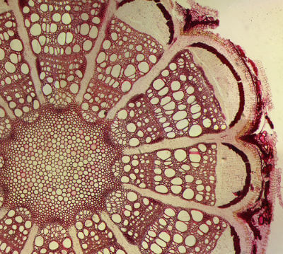
Conducting cells are long thin tubes that resemble drinking straws. They are found inside the stems and roots.
They carry (or "conduct") water from the roots of the plant to the leaves, where it is required for photosynthesis. They also carry food from the leaves to the roots and stems.

Slide 11
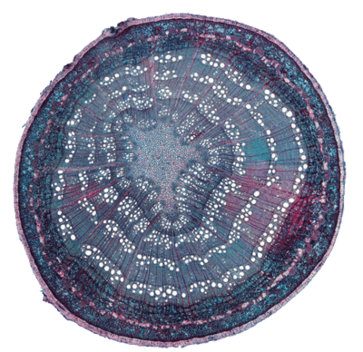
In this cross section of a plant stem, you can actually see the holes formed by the conducting cells!

Slide 12
